Slide 1
ISV Partnership
Steve Jarvis – Partner Business Evangelist (PBE)
steven.jarvis@microsoft.com

Slide 2
DX: Who are we?
Developer Experience & Evangelism (DX) leads and accelerates the creation of successful applications and services across Microsoft devices and cloud platforms through its work with ISVs and technical audiences.
EVANGELISM
ISV
TOOLS
Win the next generation of developers—students, startups and professionals
Broad and innovative platform adoption. Most successful and profitable on our platform
Evangelise our Visual Studio Developer Tools
‘Tip of the spear’ within Microsoft
Mandate to disrupt & ‘think outside the box’
Our partners innovate, challenge markets and define the future
We are measured by our partners’ success
This is DX

Slide 3

What’s a PBE and how can we help?
The Microsoft Developer Experience (DX) team has a Partner Business Evangelist (PBE) team who work with Software Developers / ISVs of all sizes.
PBE’s are:
Aligned by industries (Fin. Services, Retail, Media, Public Sector, Education, etc.).
Business/Commercial in focus (some are also technical).
Ideally suited to help you navigate Microsoft.
Your best route to the Technical Evangelist team.
Measured on the total Azure consumption of their partners.

Slide 4
Engagement Model
Envision
Discuss joint opportunities and ideation (envisioning workshop)
Develop
Architecture/Application Design Workshops (ADS) & PoCs
Technical & architectural guidance
Launch
Ensure you are successful and profitable on Microsoft platform
Focused on Azure platform (Azure, IoT, ML, WebApps etc.)
Create Go-To-Market plan: create market amplification & demand generation
Understand your strategy, goals and priorities
Connections directly with Product Teams
Craft Co-selling engagements with the Microsoft seller community

Slide 5
Azure
Azure StorSimple
Azure in Open
Azure Government
Azure SQL Database
Rights Management (RMS)
Azure API Management
Azure Site Recovery
Azure Automation
Instance Level Public Ips
Azure Redis Cache
Azure Batch
Azure Marketplace
Azure Data Factory
Stream Analytics
Event Hubs
Operational Insights
Premium Storage
Virtual Machine Converter 3.0
Cloud Platform System (CPS)
Antimalware for Cloud Services and VMs
Identity Manager vNext
Analytics Platform System (APS)
Visual Studio Community 2013
Visual studio 2015 Preview
.NET 2015
Azure RemoteApp
Azure AD Basic
SSD-based instances for Microsoft Azure VMs and Cloud Services
Azure SQL Database Auditing
Live Channels for Azure Media Services
AAD Application Proxy
New experiences in Power BI
Azure DocumentDB
Azure Search
HDInsight for Storm Public Preview & GA
Azure Zone Redundant Storage
HDInsight for Hbase
WSSC vNext tech preview
Content Protection pub preview
Intune - Nov update and Dec update
Azure AAD premium features
Multi-Factor Auth enhancements
Cloudera and Hortonworks on clustered Azure VMs
Azure Instance level IP
Azure Role Based Access Controls
VPN support pub preview
TiP Testing pub preview
Azure AD Workday A148 Integration
Azure Standard SSG
ExpressRoute S2S, P2S GA
Azure Multiple NICs
Azure Networking Appliances
Azure Traffic Manager Nested policies
Azure VM Image Gallery expansion
Azure Vnet
Azure Web Jobs
VSO datacenter expansion
VSO REST Hooks pub preview
Australia datacenter
Forced Tunneling
WSSC Azure Packs
Azure G-Serves Instances
Azure Key Vault
Drivers for SQL Server
MDM for Office 365 public preview and GA
Azure Media Services Content Protection
Azure Mobile Engagement
Node.js Tools for Visual Studio
Visual Studio 2013 updates
Auto-HA for SQL Server VM
Auto-Patching and Backup for SQL Server VMs
Azure SQL Database Increased Compatibility
Azure AD Connect Health pub preview
Azure AD MFA Per App / Conditional access pub preview
Azure RMS controlled user deployment
Azure RMS departmental templates pub preview
Azure Site Recovery SAN Replication
ASP.NET 5 Preview
Azure SDK 2.5.1
Team Foundation Server 2015 preview
Azure Machine Learning GA
Azure HDInsight for Linux Pub Preview
Azure HDInsight Support for Hadoop 2.6 pub preview
Azure SQL Database security feature - Data Masking pub preview
Azure SQL Database security features - Encryption
Azure SQL Database security features - Row Level security
Azure AD: API for SIEM
Microsoft Intune monthly updates
Remote Desktop Client for Windows Phone 8.1
Azure App Service
Azure CDN Integration
Azure Media Encoder Premium
Azure AD Premium & Basic in CSP
Azure IoT Suite
Windows Server Containers
Hyper-V Containers
Windows Server Nano Server
Azure Media Player GA
Azure Service Fabric
Azure IoT Suite
Azure Site Recovery: Protect VMWare and Physical Servers in Public Preview
Azure Backup Generally Available
Azure API Management Premium simplifies high availability and massive scale for APIs
ExpressRoute for Office 365
Azure Active Directory Dynamic Membership For Groups
Automatic Password Change for Social Media Shared Accounts
Compute-Intensive A10 and A11 Virtual Machine Instances
Remote Desktop app for Windows Phone support for Gateway and Remote Resources
Informatica Cloud Agent availability in Linux and Windows Virtual Machines
Azure DocumentDB Hadoop Connector
Azure HDInsight support for more VM sizes
Enterprise-Grade Array-Based Replication and Disaster Recovery with ASR and System Center GA
500+
New releases in
the last 12 months
500+
New releases in
the last 12 months

Slide 6
Engagement Model
Envision
Discuss joint opportunities and ideation (envisioning workshop)
Develop
Architecture/Application Design Workshops (ADS) & PoCs
Technical & architectural guidance
Launch
Ensure you are successful and profitable on Microsoft platform
Focused on Azure platform (Azure, IoT, ML, WebApps etc.)
Create Go-To-Market plan: create market amplification & demand generation
Understand your strategy, goals and priorities
Connections directly with Product Teams
Craft Co-selling engagements with the Microsoft seller community

Slide 7
Microsoft Go-To-Market Overview
Microsoft has assembled a team of marketing experts with one goal: To help make partner apps successful.
Microsoft Go-To-Market Services are specially designed to help Independent Software Vendors (ISVs) achieve their launch and growth goals for apps built on the Microsoft platform.
Press Release Support
‘App of the Day’ Social Promotion
Microsoft Partner Apps Blog Post
Mini-Case Study
Co-Branded Datasheet
Attract Customers
Engage Customers
AppCatalog Listing
Cross-Border Readiness
Self-Service Marketing Resources
GTM Partner Newsletter
GTM Partner Community Call
Accelerate Growth
Expand Partnership
Email MicrosoftGTM@Microsoft.com and visit www.MicrosoftGoToMarket.com to get started.
© 2015 Microsoft Corporation. All rights reserved. Microsoft, Windows, Windows Vista and other product names are or may be registered trademarks and/or trademarks in the U.S. and/or other countries. The information herein is for informational purposes only and represents the current view of Microsoft Corporation as of the date of this presentation. Because Microsoft must respond to changing market conditions, it should not be interpreted to be a commitment on the part of Microsoft, and Microsoft cannot guarantee the accuracy of any information provided after the date of this presentation. MICROSOFT MAKES NO WARRANTIES, EXPRESS, IMPLIED OR STATUTORY, AS TO THE INFORMATION IN THIS PRESENTATION.
7

Slide 8
Microsoft DX and ISV Partnership
DX Azure Team
Support Your App Journey
Technical Enablement
Architecture & Design Workshops
Partner Investments
Go to Market Support
Co-Selling
Cloud ISVs
Looking to build and grow your business through the Microsoft Cloud
Mutual Success
In Partnership and Collaboration our businesses grow

Slide 9
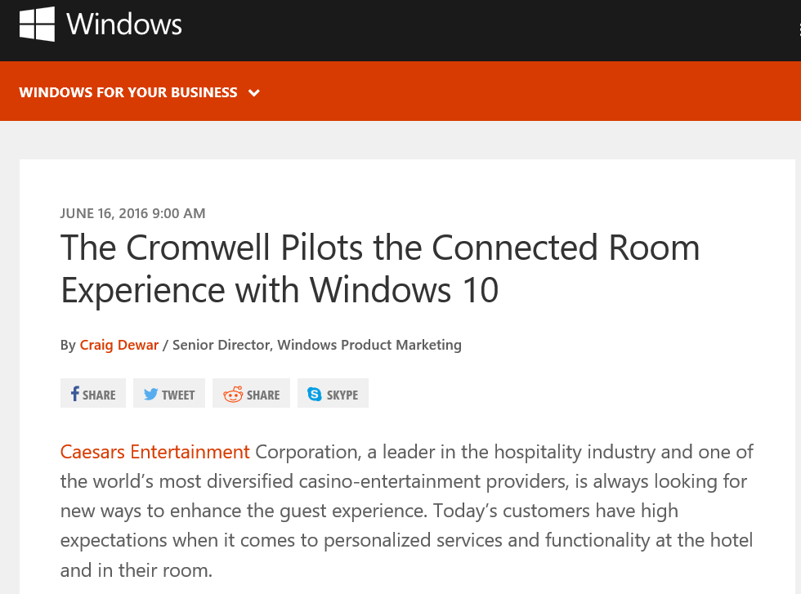
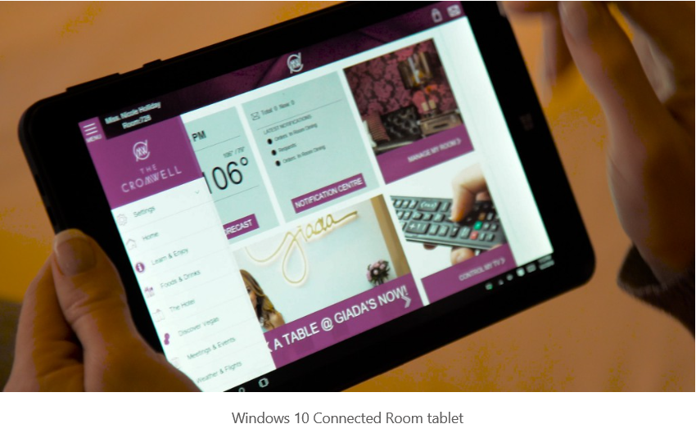

https://blogs.windows.com/business/2016/06/16/the-cromwell-pilots-the-connected-room-experience-with-windows-10/

Slide 10


http://www.x2biosystems.com/

Slide 11


Slide 12

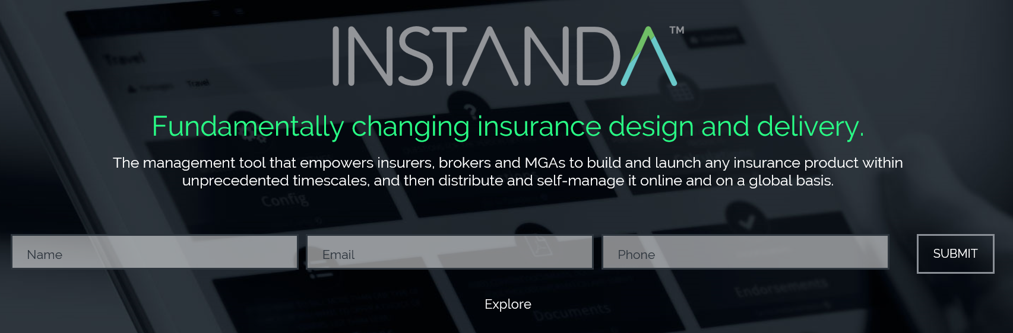
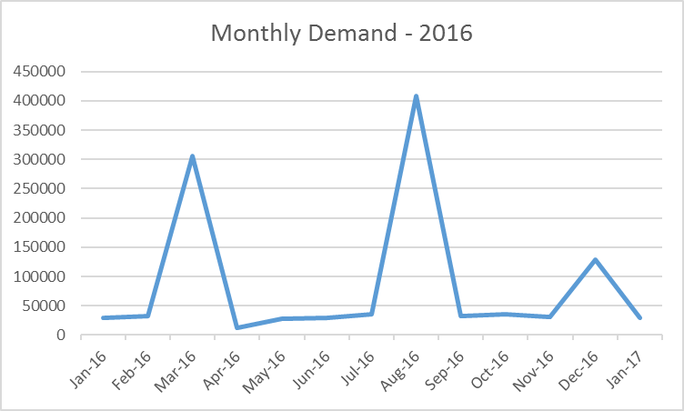
http://instanda.com/
https://huskyfinance.com/

Slide 13
What’s next?

Slide 14
How can you help me go-to-market?
What Support Options do I need?
How can I promote my solution within Microsoft?
Which Azure Components should I use?
What tools are available?
Should I use PaaS or IaaS?
Who’s my aligned PBE?

Slide 15
Upcoming Events
Data Best Practise Workshop – Sept 1st
Migrating to the Cloud
Nano Satellite Hackathon – Sept 2nd
Build Apps or Services using the BBC Microbit and Nano Satellite Kit
Winners will be showcased at the New Scientist Live Event on Sept 22nd -25th
Azure Technical Briefing Day – Sept 8th
IaaS Master Class

Slide 16
Thank You!
Steve Jarvis – Partner Business Evangelist (PBE)
steven.jarvis@microsoft.com

Slide 17
Use free/low-cost Azure licences for a pilot. Ways to get them include …
# | Program Name, URL | Audience | Cost | Duration | Free Azure Level | Requirements
1 | Azure Free Trial - https://azure.microsoft.com/en-gb/pricing/free-trial/ | Anyone | None | 30 days | GBP 125 | Credit Card for Validation (not charged unless you upgrade.)
2 | BizSpark - https://www.microsoft.com/bizspark/default.aspx | Start-ups | Free | 3 years | $150 x 5 developers = $750. Plus more. | Registered Co. < 5 years old. < $1M turnover. Have own web site.
3 | MSDN (MSFT Dev Network) or Visual Studio subscription - https://mspartner.microsoft.com/en/uk/pages/membership/msdn-subscriptions.aspx and https://www.visualstudio.com/products/subscriber-benefits-vs#SKUDetailList_1 | Dev teams | $45 /month /person Or $539/year /person | As long as subscribed | $150 /month /person | Enroll as MS Registered Partner (no cost); then purchase subscription. Credit card validation required.
4 | MPN Action Pack (for application builders) - https://mspartner.microsoft.com/en/uk/pages/membership/action-pack-application-design-development.aspx | Partners | $475/year | 12 months | $100 /month | Enroll as MS Registered Partner (no cost). Then purchase Action Pack. Ideal if one wants to earn Silver or Gold status in medium term.
5 | Azure (Customer) Pass - https://azure.microsoft.com/en-gb/offers/azure-pass/ | Partners | None | 3 months | $500 /month | Apply via MSFT account manager for chosen managed customer. Redeem online (if granted).

Slide 18
Use the available support channels …
The fastest way to get a response to your technical or account issues, is through raising a ticket via the Azure portal. Account and Billing support tickets are provided free of charge, and Technical support is available via one of the support packages listed below. See:
http://www.windowsazure.com/en-us/support/plans/
Support FAQ’s
Name | Price | Response Time | Detail
Core | Included at no extra cost | NA | Forum support Account/Billing management
Developer | $29 a month | <8 Hours | Unlimited break/fix via Web Submission NB. Not available for Azure EA
Standard | $300 a month | <2 Hours | Unlimited break/fix via Web Submission 3 x Telephone call backs per month
Pro-Direct | $1000 a month | <1 Hour | Unlimited Telephone call backs with Priority handling Escalation services Pooled A/C management Some Proactive services
Premier | >$3000 a month | <1 Hour Minimum | Unlimited Priority Telephone Assigned ADM Bespoke Proactive services/mentoring Rapid Response option
For Escalations:
Subscription Management: wasmsesc@microsoft.com
Technical Support: APTSI@microsoft.com
Professional Direct Escalation: PDAzure@microsoft.com
If you need someone to pick up the case if the Case owner is Out of the office/Away: aznext@microsoft.com.

